Slide 1


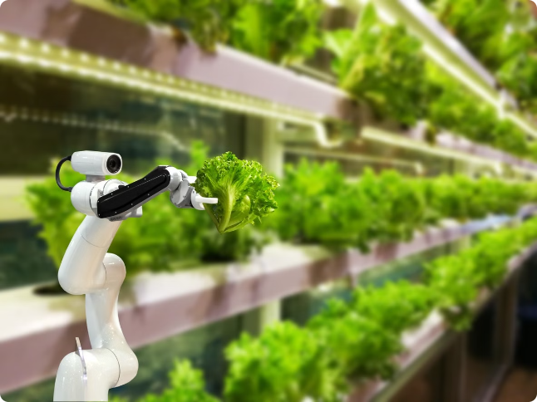
Hackathon: Agritech Innovation
In this agritech hackathon, participants will tackle challenges facing the agriculture sector through innovative solutions leveraging precision farming and IoT technologies. The goal is to develop sustainable agriculture practices that improve crop monitoring and boost productivity.
AM
by Aditya Masih and Joseph Anish

Slide 2


Problem Statement: Challenges in the Agriculture Sector
1
Unpredictable Weather
2
Pest and Disease Control
3
Resource Optimization
Climate change has led to erratic weather patterns, making it difficult for farmers to plan their crop cycles effectively.
Efficient use of water, fertilizers, and other resources is crucial for sustainable agriculture.
Pests and diseases can devastate crop yields, requiring efficient monitoring and prevention methods.

Slide 3
Technical Aspect: Precision Farming and IoT Solutions
Sensor Networks
Data Analytics
Automated Irrigation
Deploy strategically placed sensors to gather real-time data on soil moisture, temperature, and other environmental factors.
Use machine learning algorithms to analyze sensor data and provide actionable insights for optimal crop management.
Implement smart irrigation systems that adjust water flow based on plant needs, reducing water waste.

Slide 4

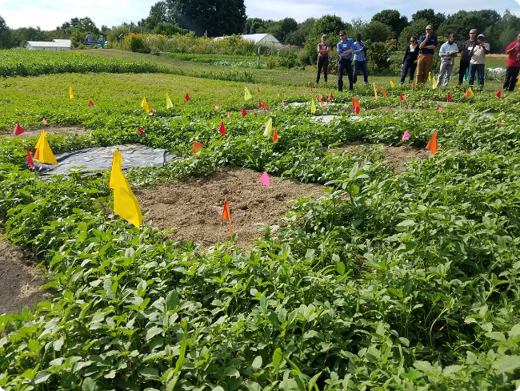
Innovative Ideas: Sustainable Agriculture Practices
Precision Farming
Vertical Farming
Use advanced technologies to optimize resource usage and minimize environmental impact.
Grow crops in vertically stacked layers, maximizing land usage and reducing transportation costs.
Renewable Energy
Waste Recycling
Integrate solar, wind, or other renewable energy sources to power agricultural operations.
Develop systems to reuse and recycle agricultural waste, minimizing environmental pollution.

Slide 5

Proposed Solution: Automated Crop Monitoring System
Sensor Integration
Automated Interventions
Deploy a network of sensors to continuously gather data on soil, weather, and plant health.
Implement automated systems to adjust irrigation, fertilizer application, and pest control based on the insights.
1
2
3
Data Analytics
Use machine learning algorithms to analyze the sensor data and provide real-time insights.

Slide 6


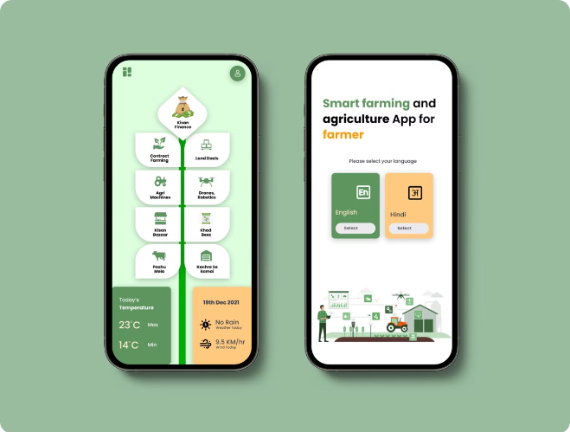


Prototype and Demonstration
Sensor Integration
Demonstrate the deployment and calibration of various sensors for data collection.
Data Analytics
Present the algorithms used to process and interpret the sensor data.
Automated Interventions
Show how the system can trigger automated actions based on the analytical insights.

Slide 7


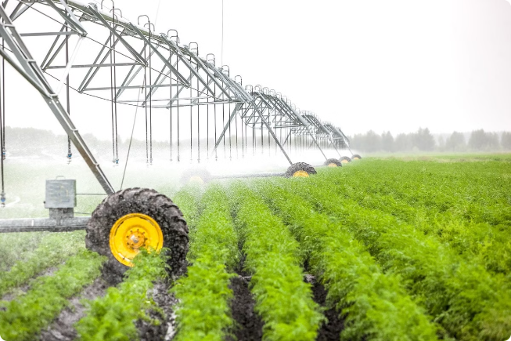


Practical Implementation and Scalability
Modular Design
The system should be designed in a modular fashion to allow for easy expansion and adaptability to different farm sizes and crop types.
Cost-Effective
Utilize affordable and readily available hardware and software components to make the solution accessible to small-scale farmers.
Adaptability
Develop the system to be flexible and capable of integrating with existing farm equipment and infrastructure.

Slide 8


Team Members
Aditya Francis Masih
Joseph Anish
CHRIST (deemed to be university)
CHRIST (deemed to be university)

